Slide 1


Lesson 1
What is the Internet?
csinschools.com

Slide 2



Learning objectives
By the end of this lesson you will be able to:
understand what the Internet is
understand what a web browser is
understand what a web server is
understand how web browsers and web servers communicate
understand what HTML is
2

Slide 3

What is the Internet?
3
Notes:
Ask the class "What is the Internet?"

Slide 4
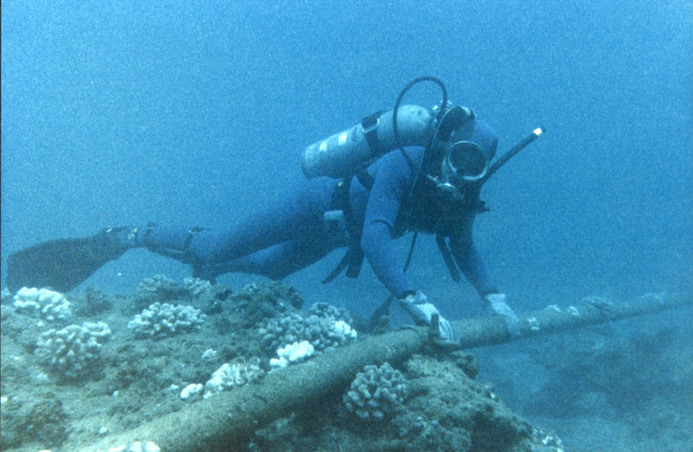
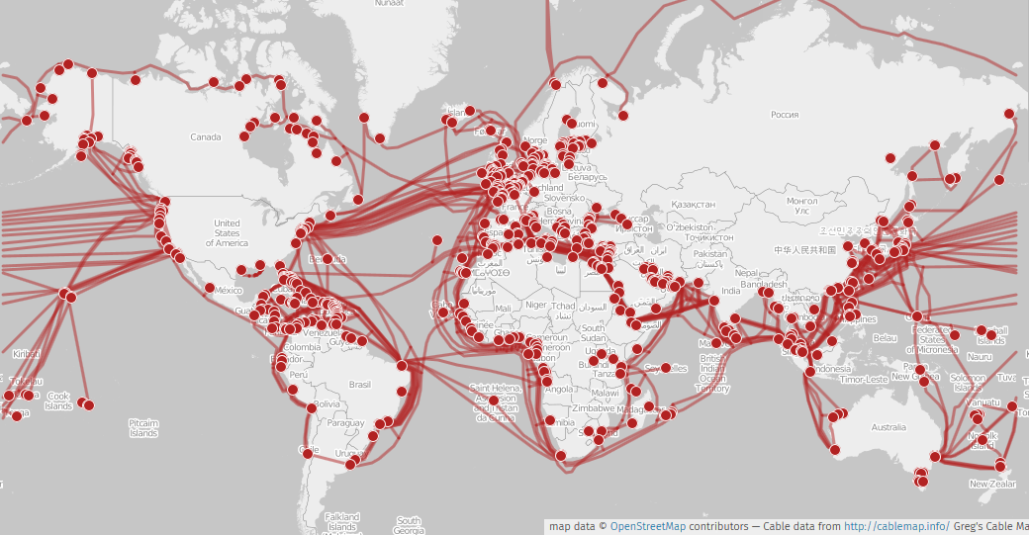

What is the Internet?
The Internet is a network of computers that are physically connected together.
There are underwater cables for the Internet!
4

Slide 5
What is an IP address?
5

Slide 6

What is an IP address?
A unique number assigned to each computer connected to a network.
This is similar to your house, where your particular address is the only one in the world!
173.18.145.12
192.134.14.32
64.175.142.15
6

Slide 7
What is a web browser?
7

Slide 8



What is a web browser?
A web browser is an application that is used to access the Internet and can display web pages.
8

Slide 9
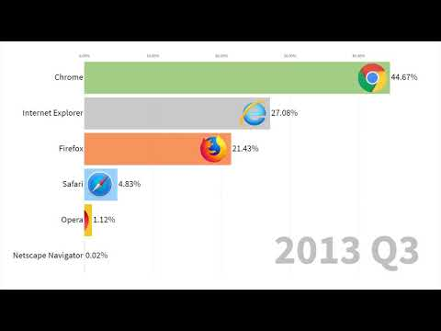
Most Popular Web Browsers (1996-2019)
Did you know that the first browser, called WorldWideWeb, was written in 1990?
9

Slide 10
What is a web server?
10

Slide 11

What is a web server?
A web server is a computer that is connected to the Internet and receives requests (often from a web browser) for a particular resource.
The web server decides on how to respond and this usually involves sending the resource back to the web browser, which will then display it.
A server serves, just like a waiter! Think of a web server as a waiter who takes your order, then brings you back your food.
11

Slide 12
What happens when you visit a website?
What happens when you type in https://csinschools.com into your web browser's address bar?
Think about this by yourself for 60 seconds
Discuss with the person next to you for 60 seconds
Have a class discussion led by your teacher about your ideas
12

Slide 13


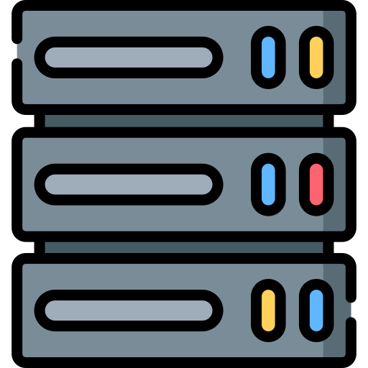
How Do Web Browsers and Web Servers Communicate?
The web browser discovers the IP address of the website csinschools.com using something called a domain name service (DNS) ...
What is the IP address for csinschools.com?
The IP address is 192.17.140.89
IP Address
The unique number given to every computer so it can be found on the Internet
Browser
DNS Server
13

Slide 14

How Do Web Browsers and Web Servers Communicate?
… and then sends a request to that IP address.
192.17.140.89, can I have the cat video?
Browser
192.17.140.89
14

Slide 15
How Do Web Browsers and Web Servers Communicate?
The server returns a status code.
status_code: 200
<HTML> … </HTML>
Status Codes
A number that tells us if the request worked
A status code of 200 means all OK
Browser
192.17.140.89
15

Slide 16

How Do Web Browsers and Web Servers Communicate?
If everything is OK, the requested resource is returned to the browser. Sometimes this is HTML code, sometimes it downloads the resource to your computer.
status_code: 200
<HTML> … </HTML>
Your screen
Browser
16

Slide 17
What is HTML?
HTML stands for HyperText Markup Language. It is a kind of programming language and is used to describe the structure of a web page. It has tags which represent how data should be displayed. For example the following code instructs the web browser to display "Computer Science" as a heading:
<h1>Computer Science</h1>
17

Slide 18
What is HTML?
HTML stands for HyperText Markup Language. It is a kind of programming language and is used to describe the structure of a web page. It has tags which represent how data should be displayed. For example the following code instructs the web browser to display "Computer Science" as a heading:
<h1>Computer Science</h1>
these are tags!
18

Slide 19
What is HTML?
HTML stands for HyperText Markup Language. It is a kind of programming language and is used to describe the structure of a web page. It has tags which represent how data should be displayed. For example the following code instructs the web browser to display "Computer Science" as a heading:
<h1>Computer Science</h1>
We'll talk more about them in Lesson 2
19

Slide 20
What is a URL?
A URL (Uniform Resource Locator) specifies where a specific resource such as a web page can be found on the Internet.
A URL contains detailed instructions on where to find something on a particular server.
e.g. my socks are located in Australia, Victoria, Whoville, 14 Smith Street, in my bedroom, in my closet, 3 drawers down.
14smithstreet.whoville.vic.au/bedroom/closet/drawer/3/socks
Examples
https://csinschools.com/
https://csinschools.com/news/
https://www.google.com.au/
Can you think of another example?
20

Slide 21

What are the parts of a URL?
https://csinschools.com/about/
https://
This is the protocol to use. HTTP stands for HyperText Transfer Protocol and is used for web pages. HTTPS is the Secure version of the protocol where all data sent between your web browser and the web server is encrypted.
Encrypted: written in a secret code so that only certain people can read it.
21

Slide 22
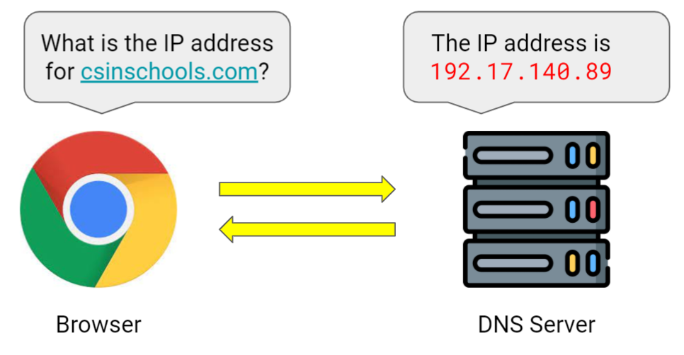
What are the parts of a URL?
https://csinschools.com/about/
csinschools.com
This is the domain name.
The web browser will use a domain name service (DNS) to find out the IP address of this domain (the first step our browser makes when we type in a URL!)
22

Slide 23
What are the parts of a URL?
https://csinschools.com/about/
/about/
This is the path.
This tells the website which specific resource to request. If there is no path given then the default web page will be requested. This is a common way to implement multiple pages on a website.
23

Slide 24

Query String
https://www.google.com.au/search?q=csinschools
?q=csinschools
This is the query string. It's optional and starts with a question mark (?). In this case it assigns the value of 'csinschools' to the variable 'q'. The web server might use this information to modify the resource, or to narrow down a search.
Imagine a restaurant. The URL has the path to the kitchen inside the restaurant. You tell the waiter you want a burger. This could be a query string like so:
https://www.restaurant.com/kitchen?order=burger
24

Slide 25


Query String - Multiple Variables
https://www.youtube.com/watch?v=m2Ux2PnJe6E&t=32s
Multiple variables can be passed in the query string by using the & character. In the above URL we have two variables, v=m2Ux2PnJe6E which specifies which video to watch and t=32s which specifies to start the video at the 32 second mark. Using our restaurant order query string from before, this could let us order chips with our burger:
https://www.restaurant.com/kitchen?main=burger&side=chips
25

Slide 26
Searching via the Address Bar
In most web browsers you can perform a search rather than type in a URL. What website are you taken to when you type in the word "coding" in the address bar rather than a URL?
26

Slide 27
Searching via the Address Bar
In most web browsers you can perform a search rather than type in a URL. What website are you taken to when you type in the word "coding" in the address bar?
When I try this I am taken to the following URL:
https://www.google.com/search?q=coding&rlz=1C5CHFA_enAU774AU774&oq=coding&aqs=chrome..69i57j69i59j69i60l2j69i61l3j69i60.630j0j9&sourceid=chrome&ie=UTF-8
Everything that goes into the address bar must be a URL. If we type something that isn't a URL, the browser assumes we're searching for something and converts our search term(s) into a URL, then shows us the result!
Do you get a different URL to this one? Why do you think that might be?
27

Slide 28

Quiz Time
Take the following Kahoot to check your understanding!
https://create.kahoot.it/details/60e53fb9-ef89-43ea-aab3-53017c6cabd1
28

Slide 29
Summary
The Internet is a network of computers that are physically connected together.
An IP address is a unique number assigned to each computer connected to a network.
A web browser is an application that is used to access the Internet and can display web resources.
A web server serves resources upon receiving requests.
HyperText Transfer Protocol (HTTP) is used by web browsers and web servers to communicate with each other.
A URL specifies where a resource such as a web page can be found on the Internet.
29

Slide 30


Reflection: Exit pass
What is one new thing you learnt today?
Write it on a sticky note and stick it on the board before you leave the classroom
30

Slide 31
Extension
In the following slides we will look at how an application such as a web browser communicates with a web server.
31

Slide 32
Viewing the HTML Source of a Web Page
HTML is used to specify how a web page should be displayed
You can view the HTML of a web page in most browsers
On Google Chrome this is done by right clicking and selecting "view page source"
You can also use the Inspect tool (right click -> "Inspect") to change the HTML of a page.
If you try the Inspect tool, compare the web page to the person next to you. Did it change their web page? Why or why not? What happens when you refresh?
32

Slide 33
How Does Your Browser get the HTML?
When your web browser requests a resource, it finds the IP address based on the domain name, then sends a request to the web server. The web server then decides how to respond, usually returning the HTML of the resource.
curl is a command line application that can also do this.
If you are on Windows, open Command Prompt
If you are on Mac, open Terminal
The next slide has some examples of curl commands
33

Slide 34
Example CURL Commands
curl https://csinschools.com
View the HTML of a web page you would see if you viewed the source from a web browser.
curl -v https://csinschools.com
see the step by step process of the connection.
curl --version
shows information about curl including the protocols it supports
34

Slide 35
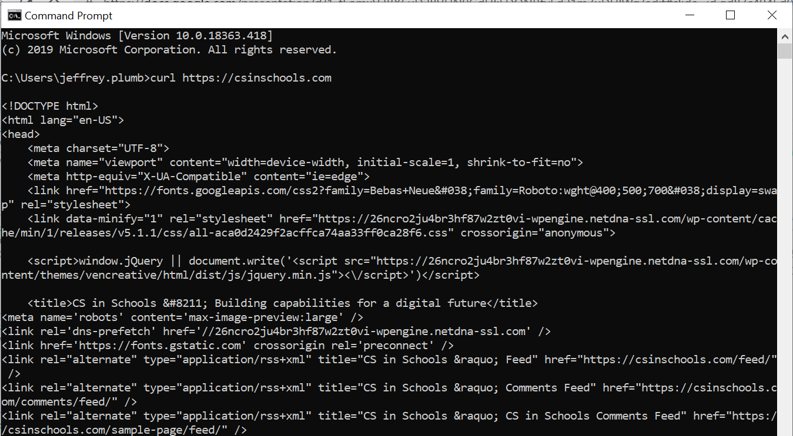
Example CURL Command
35

Slide 36
License Information
These CS in Schools lessons plans, worksheets, and other materials were created by Jeff Plumb and have been modified by the team at CS in Schools. They are licensed under a Creative Commons Attribution-ShareAlike 4.0 International License.
Images, in order of appearance:
"Diver checking underwater cable" by robot is licensed under CC BY-SA 4.0
"Map of the underwater internet" by Greg Mahlknecht is licensed under CC BY-SA 4.0
"Web Hosting Melbourne" by Traffic Radius is licensed under CC BY-SA 4.0
"Server" by Freepik on Flaticon
"Desktop" by Freepik on Flaticon
"Cat" on pxfuel
"Lock" by Freepik on Flaticon
"Waiter" by Freepik on Flaticon
36

